Slide 1

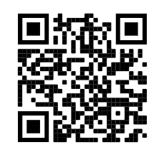

LOGO DETECTION PROJECT
Alberto Allegri, Aliya Davletshina, Niccolò Diana
Beatrice Guidotti, Kasra Zamanian

Slide 2
01
02
PRELIMINARY STUDIES
DATA PREPROCESSING
04
05
RESULTS & STATISTICS
FUTURE STEPS AND CONCLUSIONS
03
MODELS & SETTINGS

Slide 3
01
PRELIMINARY STUDIES

Slide 4


Resizing
640x640
17 logos
Roughly 40k raw images from social media
Brightness
+/- 27%
Shear and Rotation
bounding box level
Mosaic
Blur
1.25 px
Hue
+/- 15%
Notes:
Preliminary study on the task at hand, which is specifically: object detection on companies logos, and the pictures are taken from social networks (meaning typically taken from a cellphone with a relatively high resolution).
Therefore we have thought of the following image augmentations for all the images, using roboflow:
Resizing to 640x640, speeding up computational complexity limiting the pixel number and conforming to most algorithm’s standards.
Brightness to adjust to real-life situations, in which the amount of light in a setting can vary
Bounding box shear and rotation, for images captured at different angles and positions
Mosaic, to make the algorithm more accustomed to tiny occurrences of the logos
Blur, to account for unfocused background logos, especially in closed-up shots
Hue, to partially solve the problem of commonly used color filters on social media images

Slide 5
02
DATA CLEANING

Slide 6
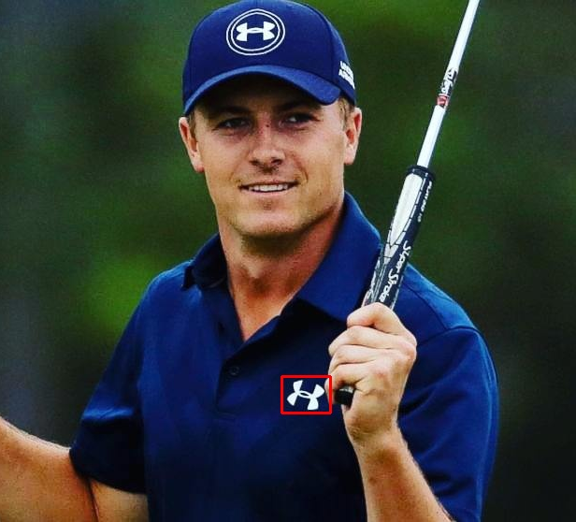
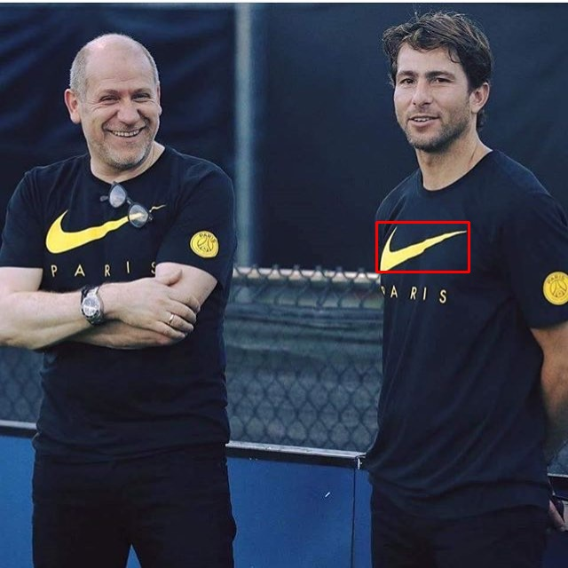
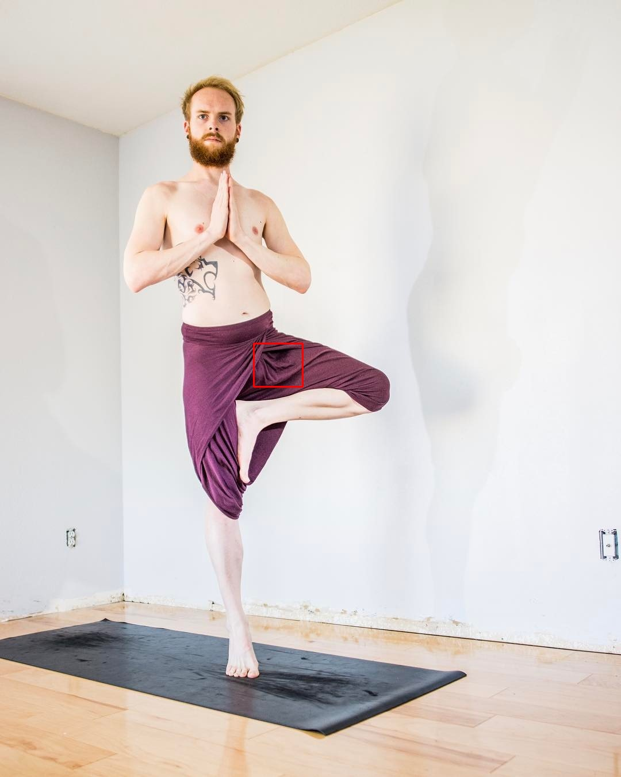
OUR PROCESS
LOGO | STARTING PICTURES | CLEAN PICTURES | % OF DISCARDED PICTURES
Nike | 5000 | 4157 | 16.86%
Adidas | 5000 | 4449 | 11.02%
Under Armour | 1687 | 1298 | 23.06%
Puma | 1149 | 796 | 30.72%
The North Face | 1243 | 822 | 33.87%
Starbucks | 4535 | 3340 | 26.35%
Apple | 2241 | 1451 | 35.25%
Mercedes Benz | 2352 | 1996 | 15.14%
NFL | 2402 | 1477 | 38.51%
Emirates | 1046 | 71 | 93.21%
Coca Cola | 1509 | 963 | 36.18%
Chanel | 968 | 538 | 44.42%
Hard Rock Cafe | 1251 | 843 | 32.61%
Toyota | 823 | 699 | 15.07%
Pepsi | 748 | 531 | 29.01%
Selected max(5000, num_images_logo)
01
02
03
Many images wrongly annotated
Choice: filter out of training set all images with multiple unannotated logos
Notes:
The main problem of the raw data came from the fact that many of the images were not correctly annotated (or even more frequently contained several logos, for which only one was annotated), thus compromising the whole training. We had then two paths we could follow:
Re-annotate all the images
Keep out of the training set all of the images which possessed multiple unannotated logos.
We eventually chose the second, since we deemed the number of images to be enough to correctly train a model. Therefore we selected max(5000, num_images_logo) for every logo and put it on a training dataset. For our large model the distribution of images was the following (comparison before and after). Of course this would not imply a worse model in case of multiple logos, because the classification is applied multiple times region-wise.

Slide 7
03
MODELS & SETTINGS
Notes:
After having tried models like ResNet50 and some versions of Efficientdet, we eventually decided to focus on Yolo given its promising results, blazingly fast inference time, and relatively quick training time. <show number of parameters of model, say quickly how it works>
Number of images used for training, type of GPU

Slide 8
YOLOv5l
367 layers
Backbone layers frozen
Fine-tuning on the rest
46,183,668 total parameters
90,000 images (train+validation)

Slide 9
04
RESULTS & STATISTICS
Notes:
IoU, mAP, training time, learning curve,

Slide 10
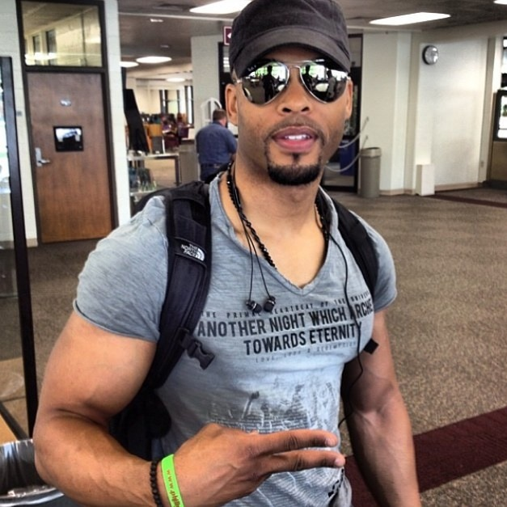
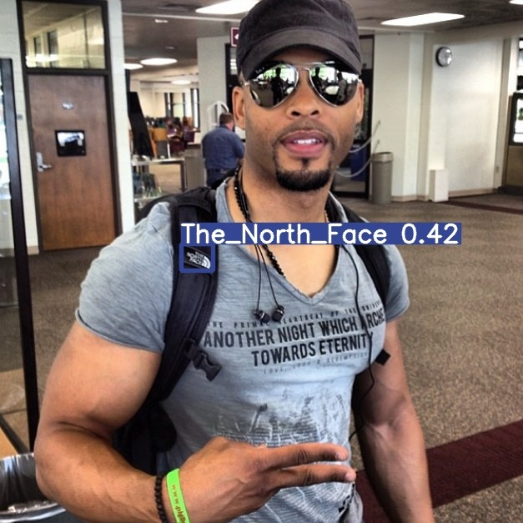
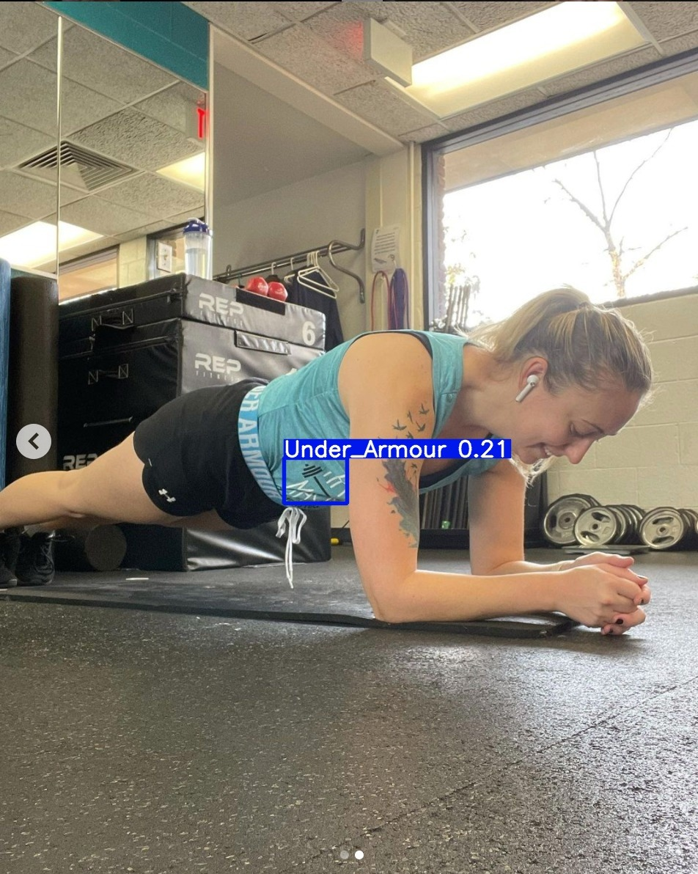

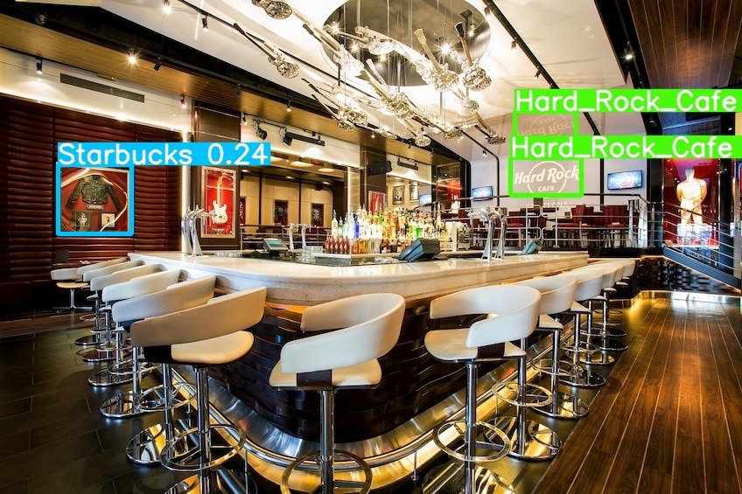
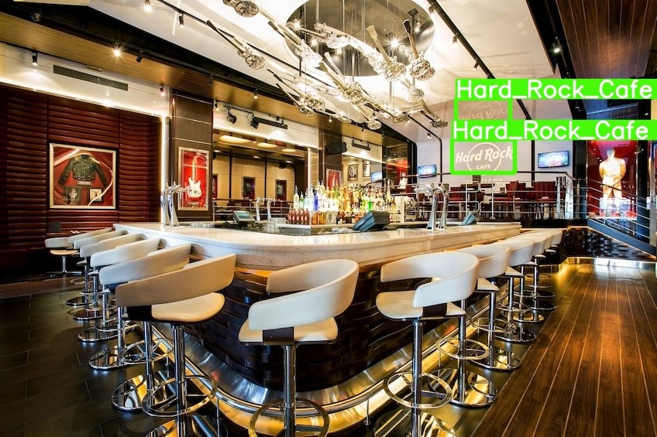
YOLOv5l
YOLOv5s
version 2
Notes:
Google images

Slide 11
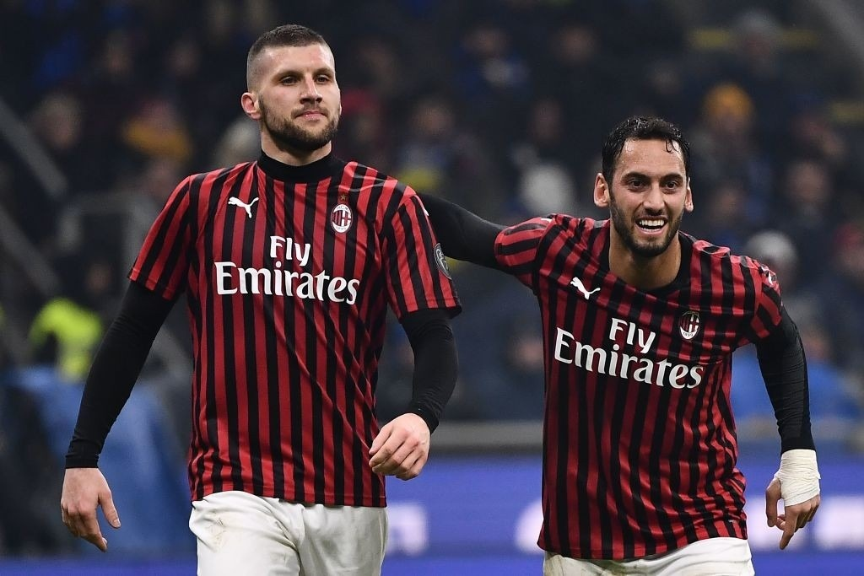
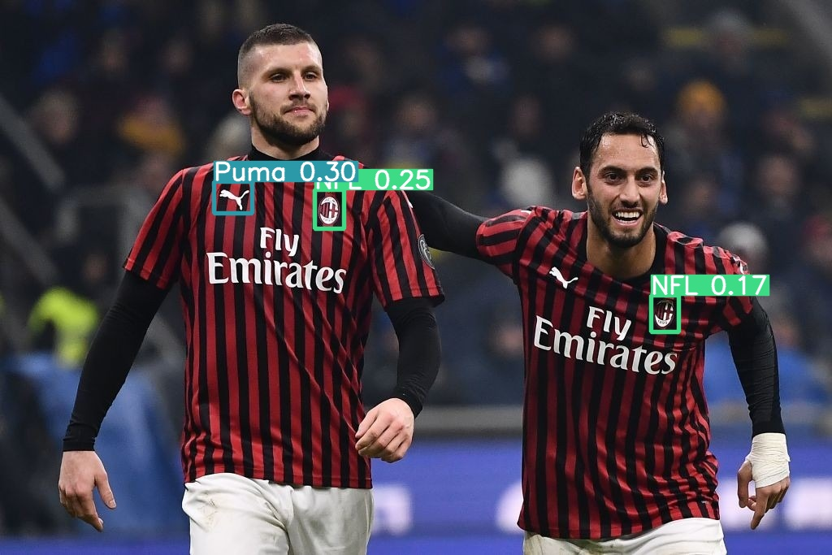
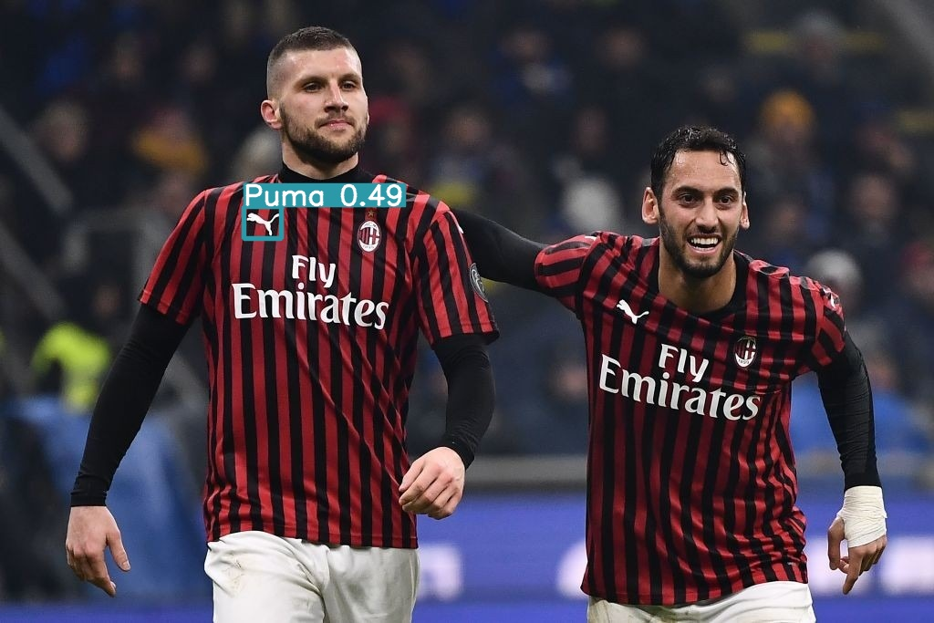
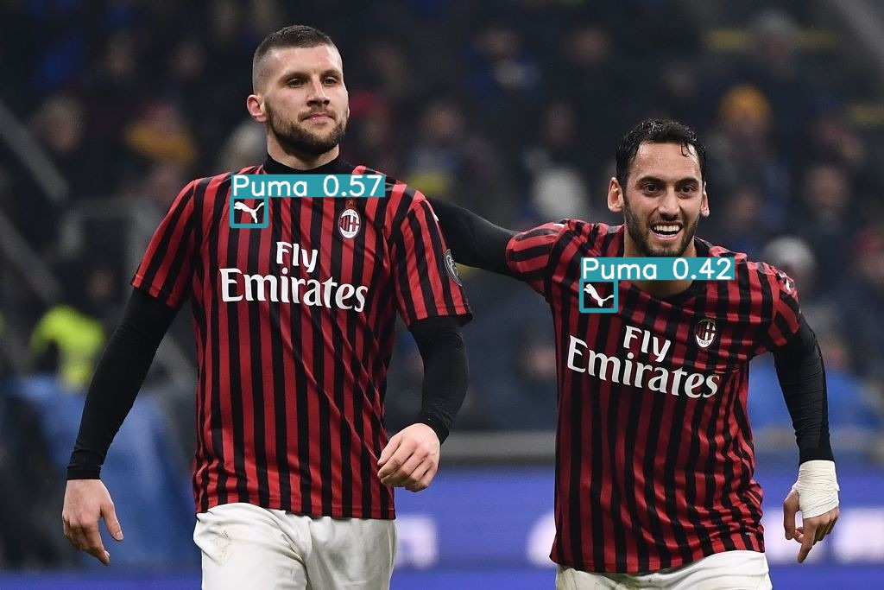
YOLOv5s-Dirty data
YOLOv5s-clean data
YOLOv5s-fine-tuned
YOLOv5s-extra-clean data
YOLOv5l-extra-clean data

Slide 12
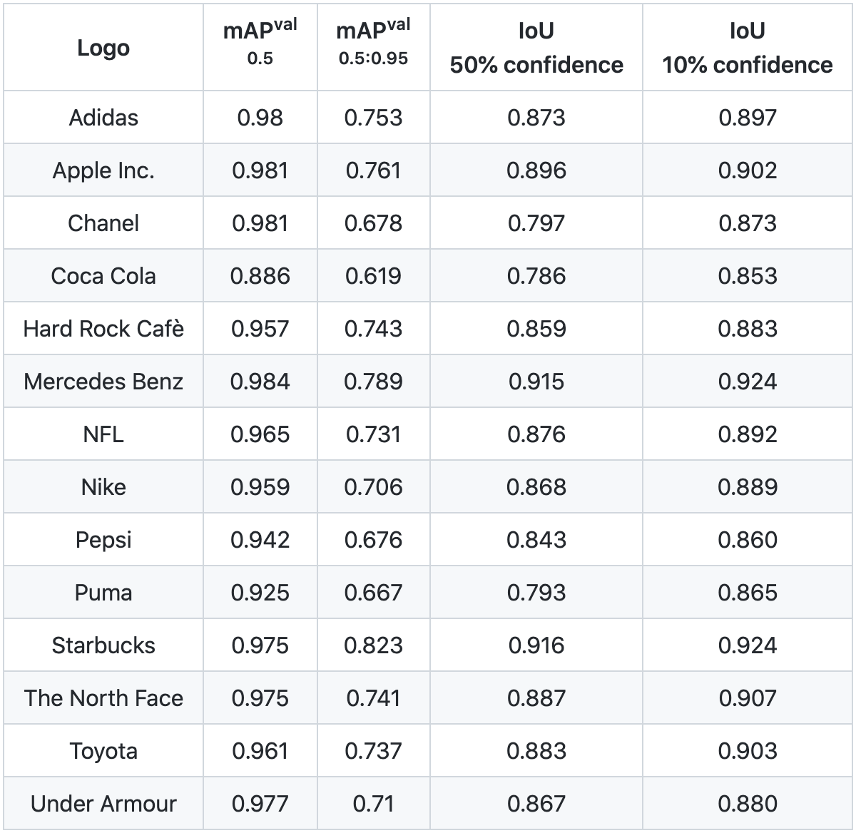
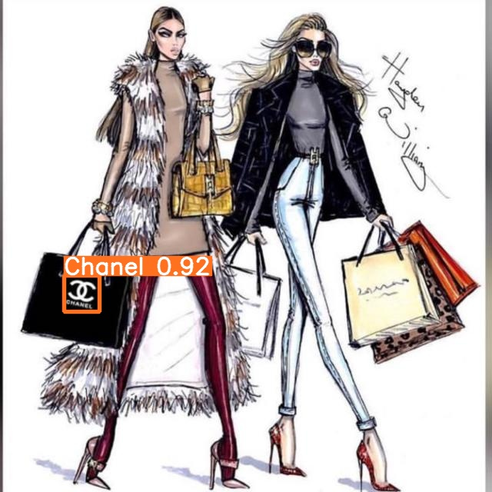
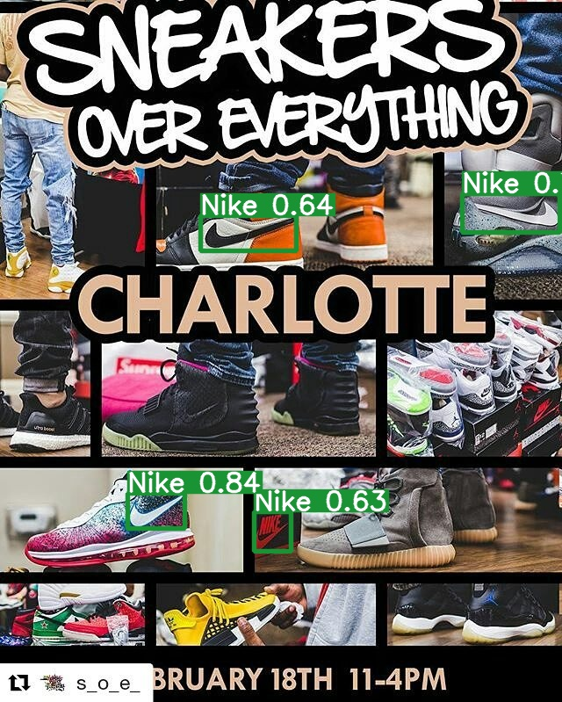
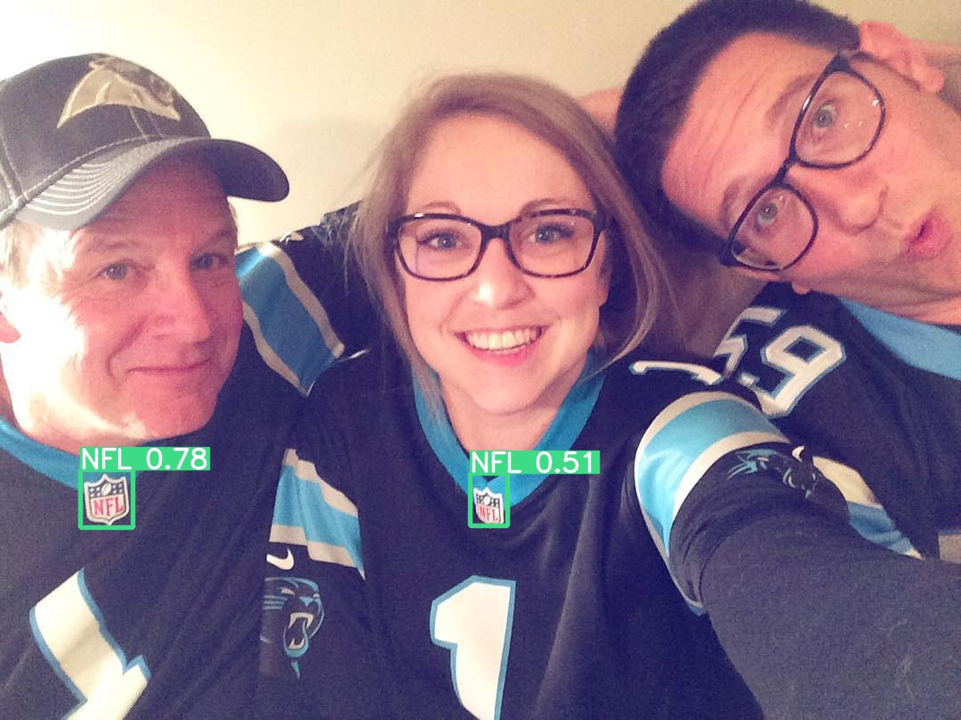
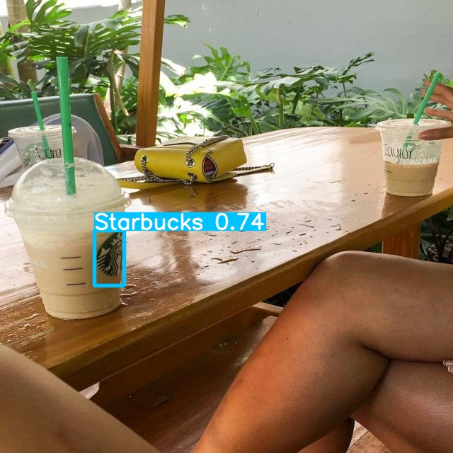
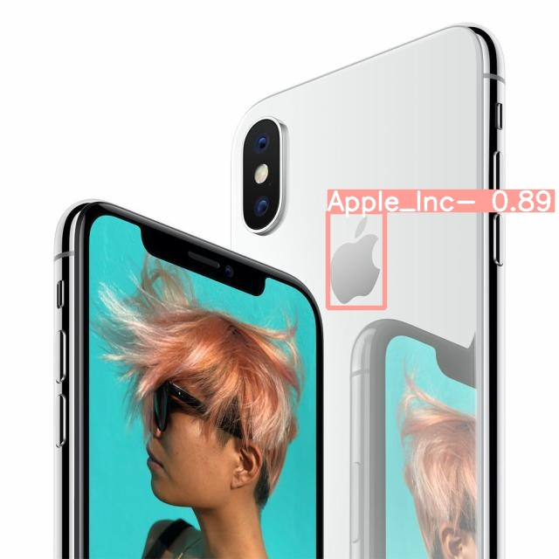
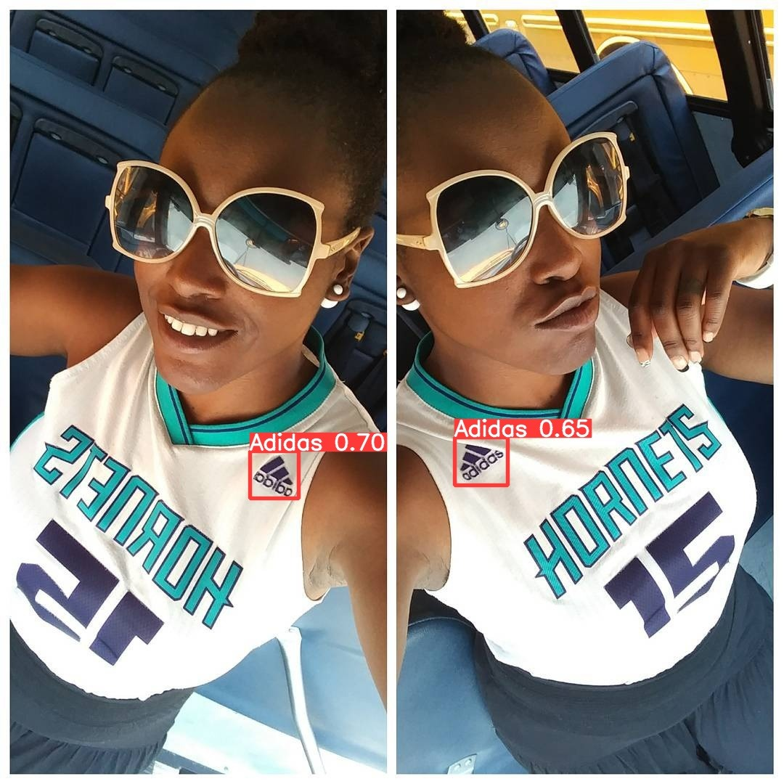
89 %
Average IoU
>10% confidence
86 %
Average IoU
>50% confidence
Mean Average Precision and Intersection over Union for YOLOv5l

Slide 13
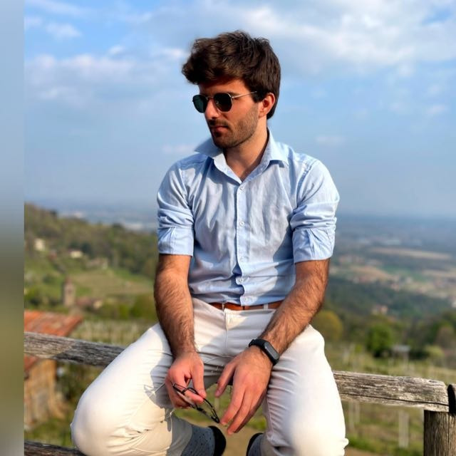
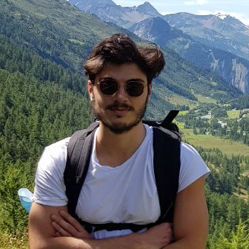
TESTIMONIALS
—LOUIS LACOMBE, TOULOUSE
—ROCCO GAZZANEO, SENISE
“Never seen such an amazing model”
“Detects much better than human beings”

Slide 14
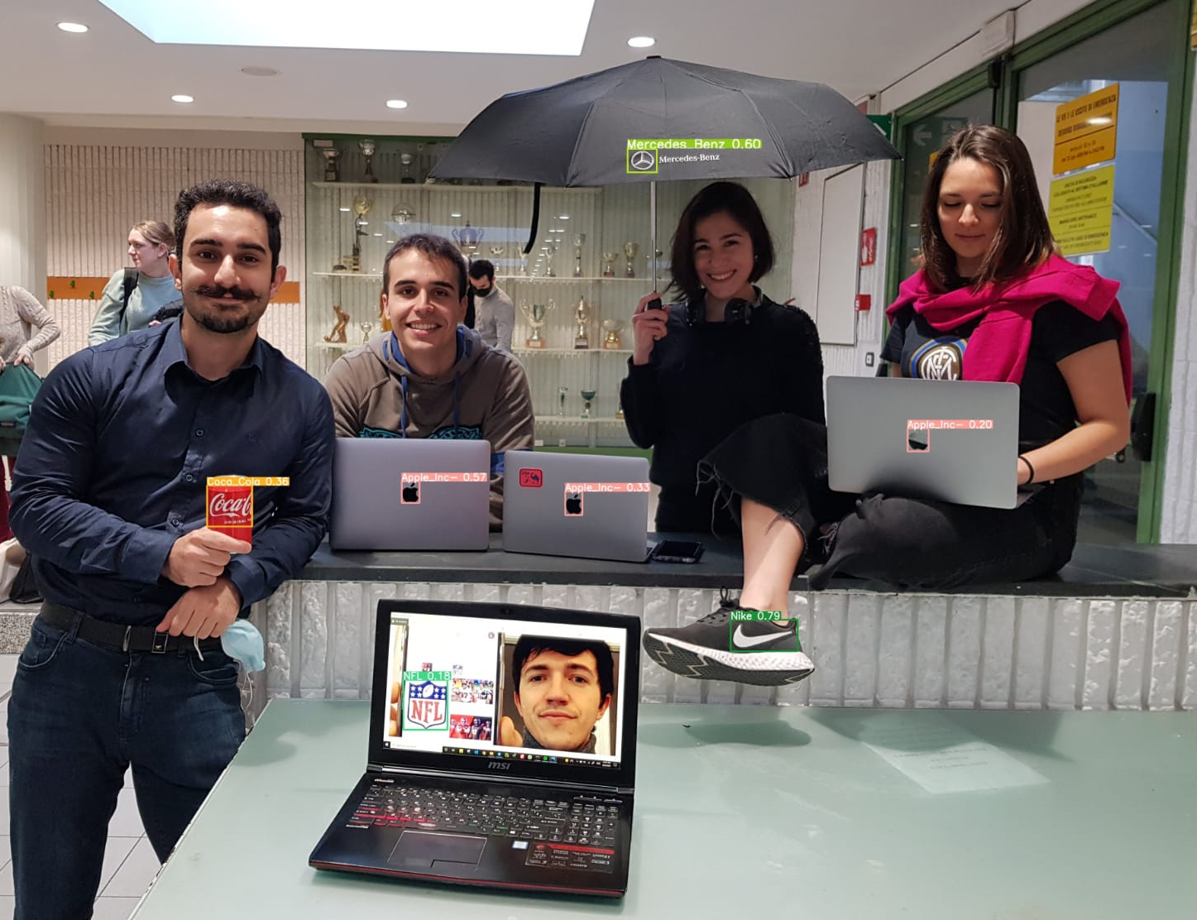

Slide 15
Ready?

Slide 16
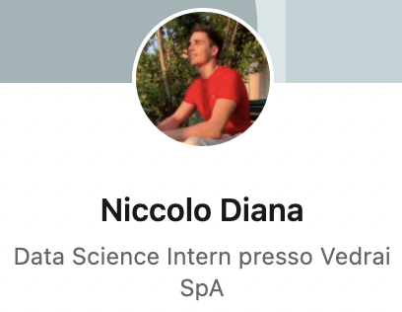
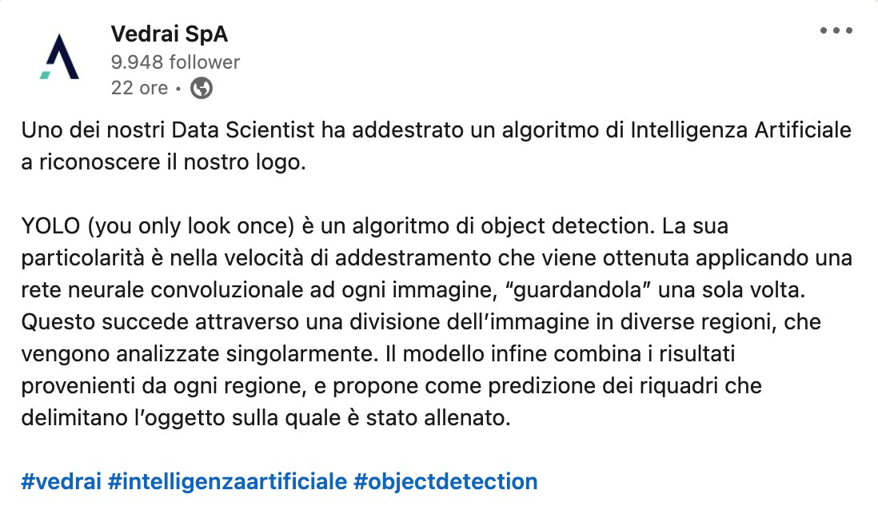
FROM KNOWLEDGE TO BUSINESS VALUE

Slide 17
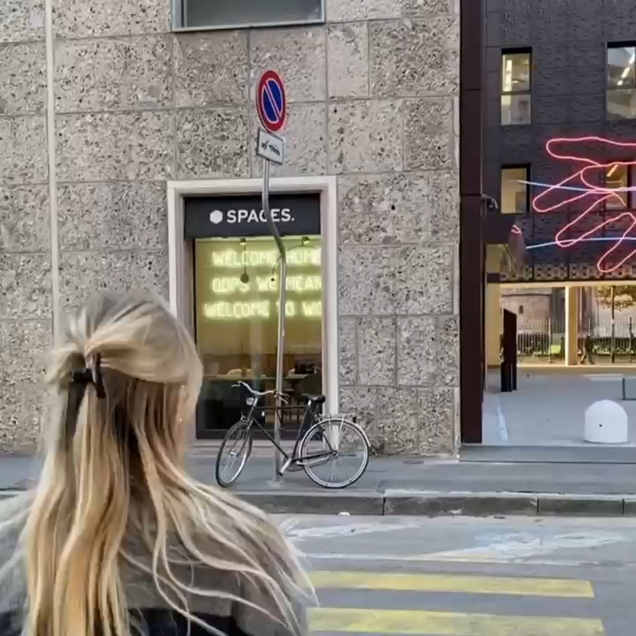

Slide 18
05
FUTURE STEPS AND CONCLUSIONS

Slide 19
FUTURE STEPS
AUGMENTATION
YOLO
OTHER MODELS
Stretch logos both horizontally and vertically
Try final version (v5lx) With multiple fine-tuning steps
Try out different models (E.g. Efficientdet v6+)
Notes:
Future step on the augmentation is to try to stretch the logos horizontally and vertically (didn’t try yet because roboflow does not offer that feature).
Future step on the same model (yolo) is to try the final version, v5lx.
Future step on the model is to try out different models, perhaps Efficientdet v6+, which is more computationally intensive than yolo (couldnt run it on the machine), takes more time to train and to to inference, but has shown to outperform yolo in several occasions in precision (suggestable for a higher IoU, but less for production).

Slide 20

THANK
YOU!

